Slide 1
Share-ops

Slide 2
MINI-Project
Submitted by:-
Abhishek Singh(181500027)
Abhishek Yadav(181500031)
Achyut Kumar Tiwari(181500034)
Arpan Khandelwal(181500129)
Kuldeep Kumar(181500339)
Submitted to:-
Mr. Neeraj Khanna

Slide 3
Introduction
In this project, we are trying to build a fast file sharing system which include detection, data transmission. Our problem can be simply described as that when 2 mobile devices encounter with each other, one need to detect quickly whether the other one has the file it need and furthermore, we can divide files into chunks and use some algorithm to identify the existence of the chunks. However, in the real case, it could be multiple devices share the files at the same time.

Slide 4
Requirements
Hardware- | Ram of 3gb (minimum) Available size of 5gb
Software- | Android version of kitkat4.4.4 and above

Slide 5
Chapters
we completed this project in mainly 4 parts.
Those are:
Learning
Designing
Coding
Error solving

Slide 6
Chapter-1
In this part(duration) we studied android developing course on Udemy.com and achieved certifications
Those certification are provided blow-

Slide 7
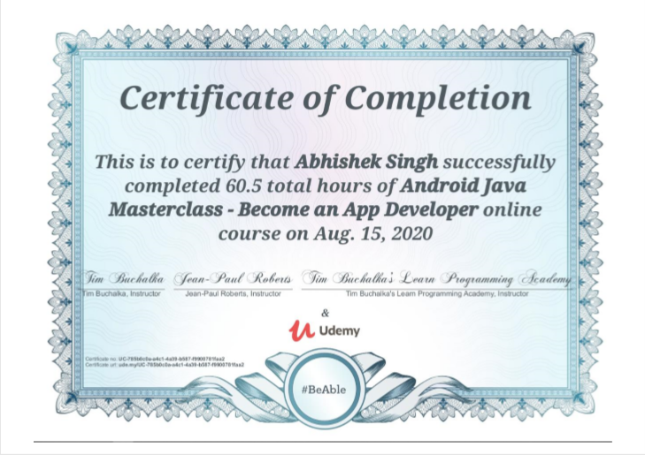

Slide 8


Slide 9
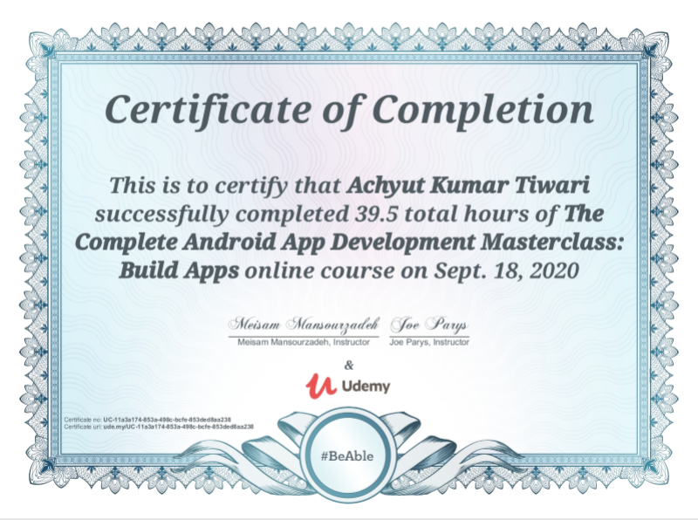

Slide 10
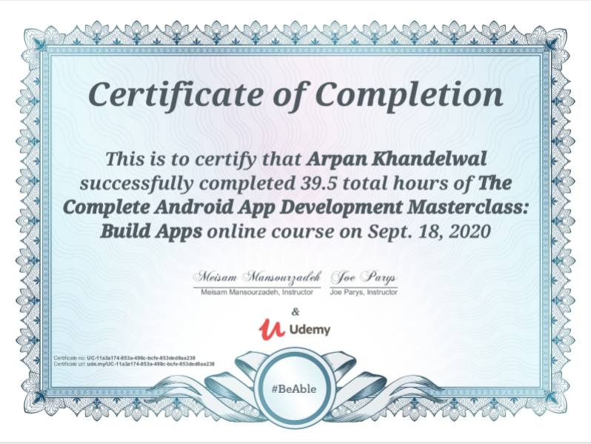

Slide 11


Slide 12
Chapter-2
In this part we made a rough sketch of the design of the application by researching various sharing applications available on play store
Such as-
Zapya
ShareMe
Shareit
InShare
And some more..

Slide 13
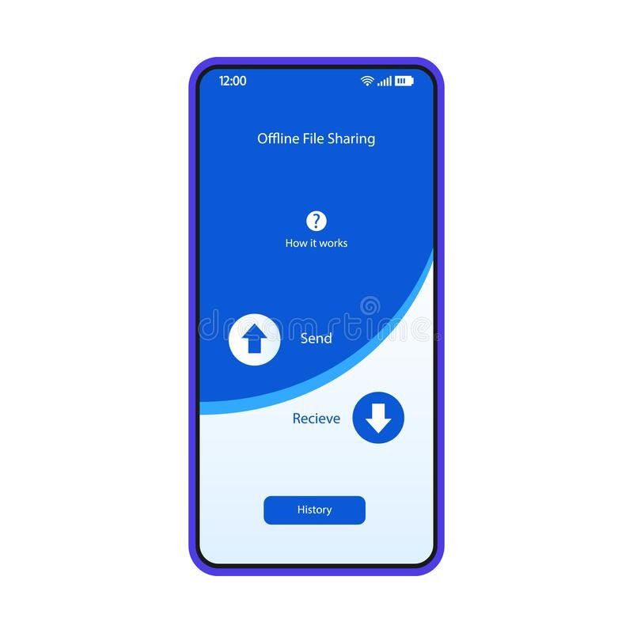
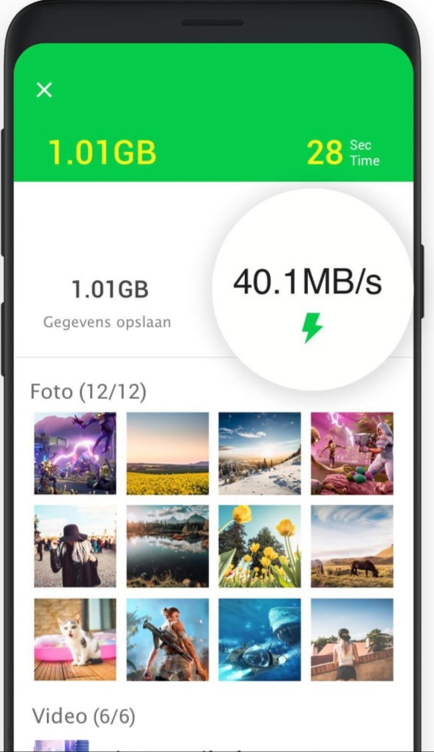
Here are some screen shots of our decided layout

Slide 14
Chapter-3
In this part we collaborated on github and coded our respective give problems with the help of stack overflow and youtube.
Here below are some screen shots of our code-

Slide 15
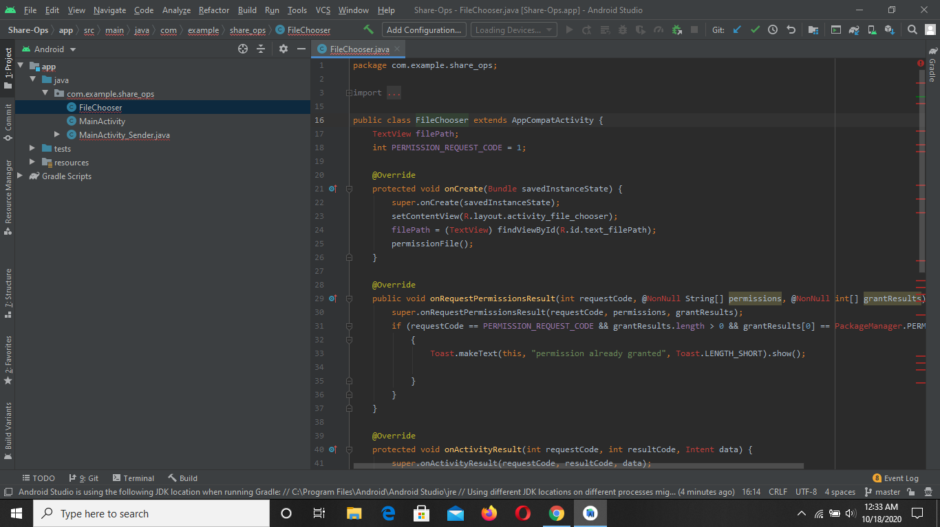

Slide 16
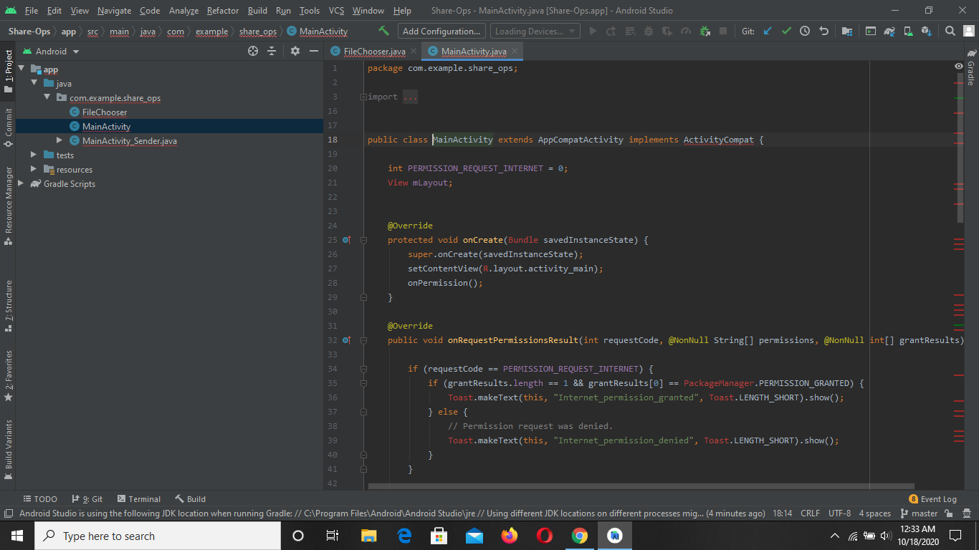

Slide 17
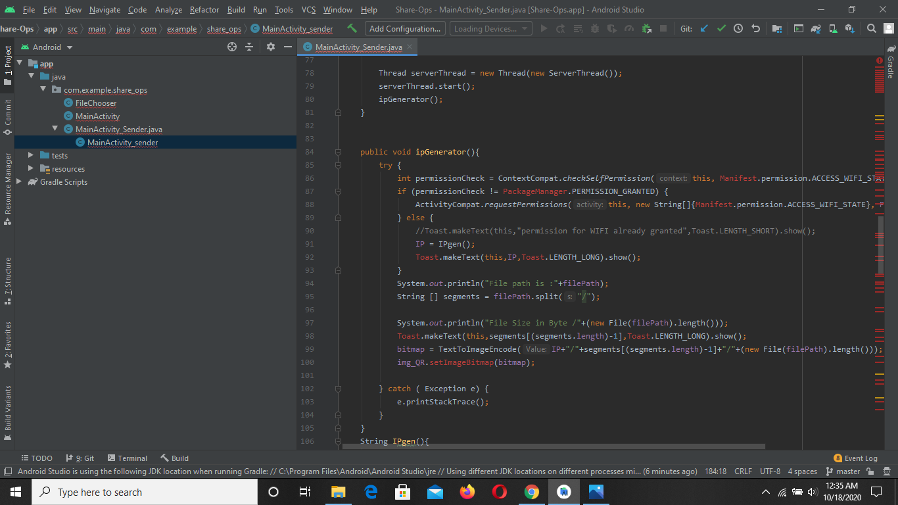

Slide 18
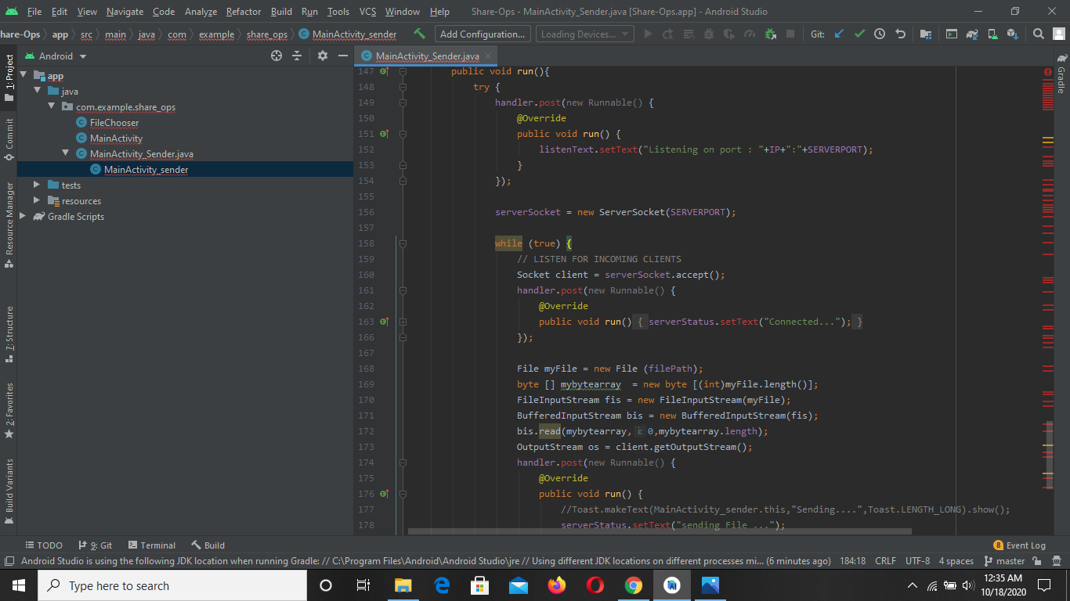

Slide 19
Chapter-4
During this part when we were about to complete our projects we faced some difficulties
Such as:
Our barcode reader failed
Our layout overlapped
Our code had many bugs

Slide 20
But we overcomed those difficulties with the help of stack overflow , google and teamwork.
And finally here are some screen shots of our final work:-

Slide 21
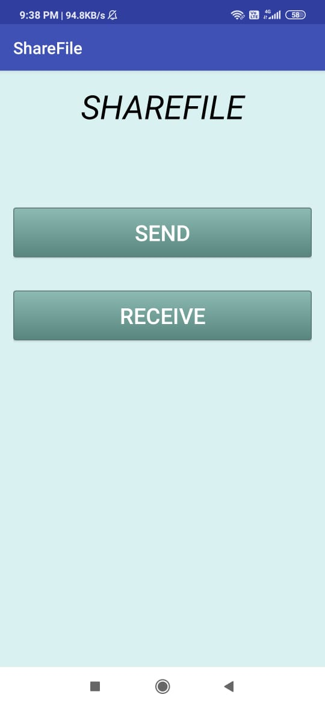

Slide 22
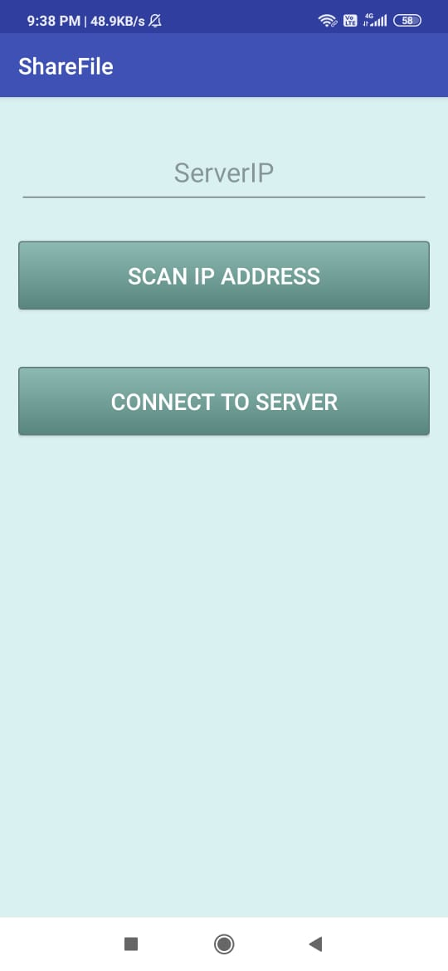

Slide 23
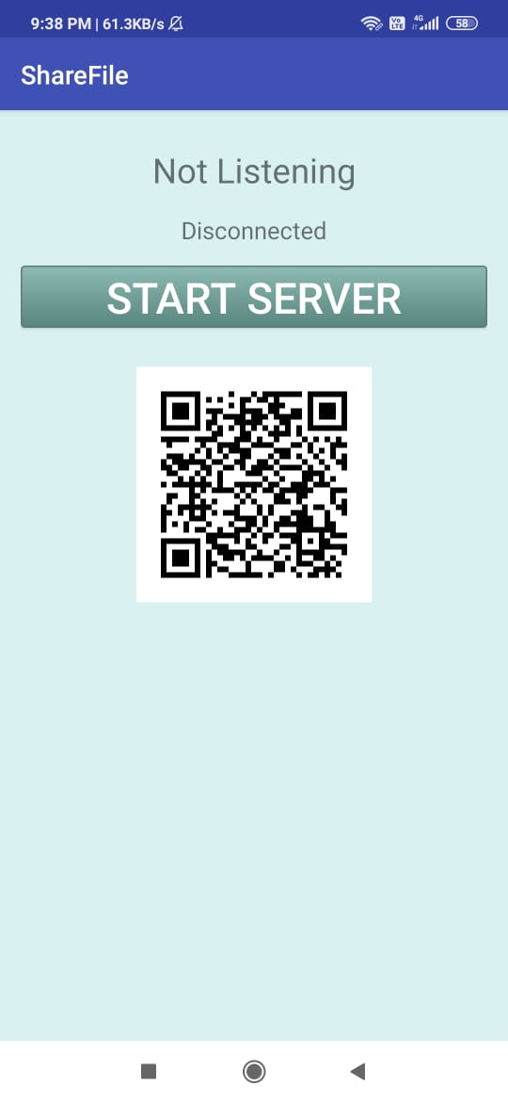

Slide 24
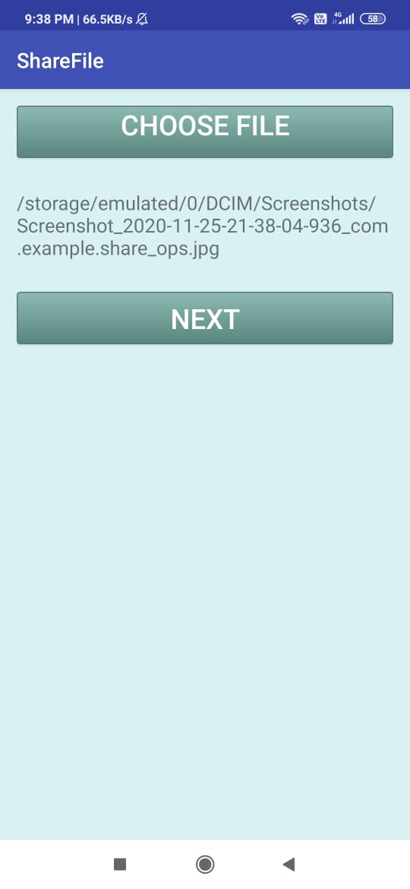

Slide 25
Thank you....

